Slide 1
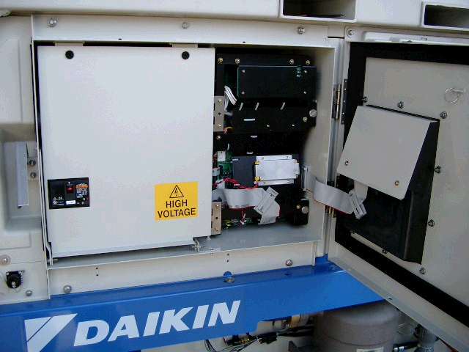
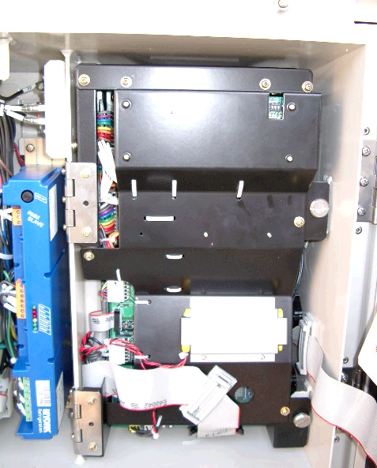
Replacement of controller (DECOSⅢc)
Open the control cover.
Turn off the circuit breaker
Controller
(DECOSⅢc)
MODEM

Slide 2
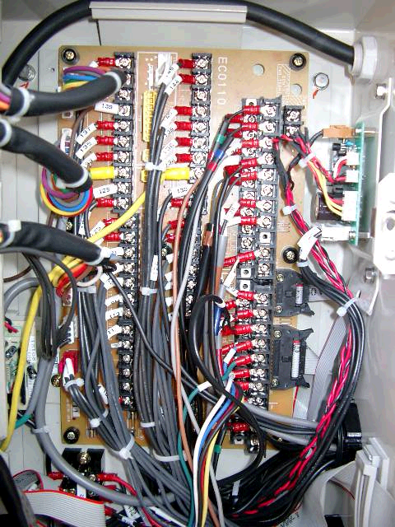
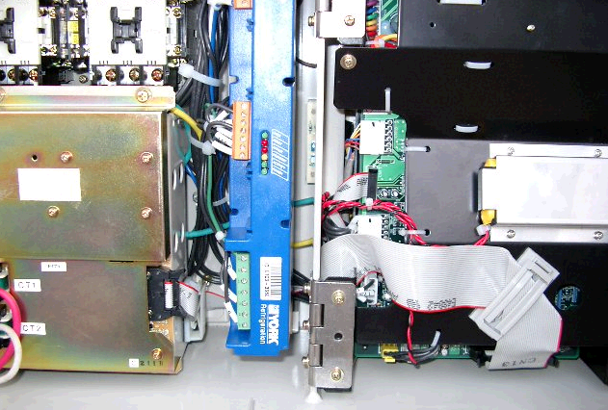
Replacement of controller (DECOSⅢc)
①Disconnect connector CN1, CN2, CN3,CN4,
CN6 and CN7 on Terminal board.
Terminal board
②Disconnect connector CN2 on PT/CT board.
③Removal of rechargeable battery and disconnect
connect CN14 on CPU board.
CN3
CN2
④Disconnect connector CN13 on CPU board.
Hinge
CN7
CN7
PT/CT board
CN2
CN14
CN13
Rechargeable
battery
CN4
CN1

Slide 3
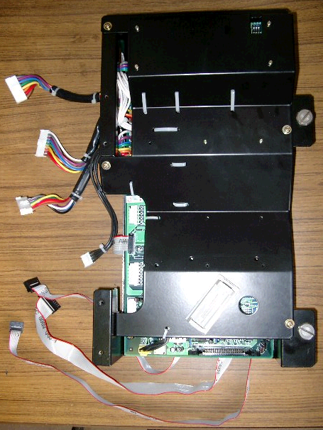
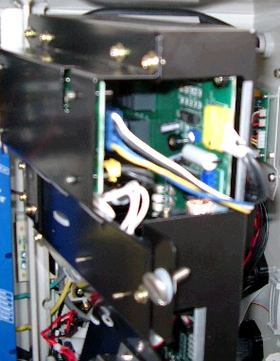
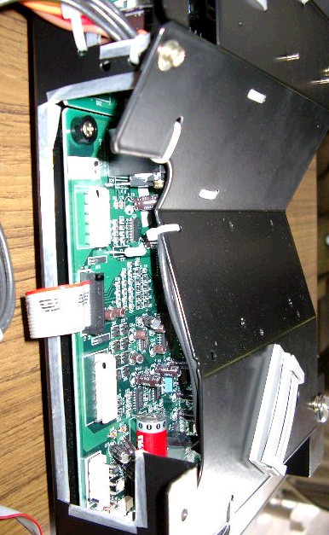
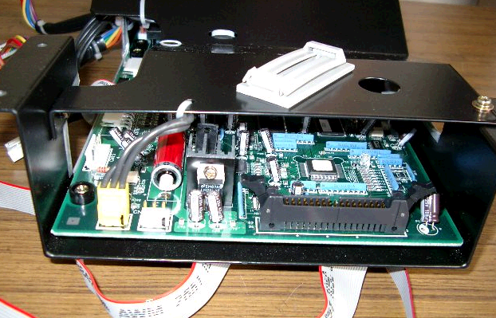
Replacement of controller (DECOSⅢc)
⑥Disconnect connector CN84 on adapter board.
【Controller】
⑦Disconnect connector CN15, CN17
and CN18 on CPU board.
⑧Remove 2 pieces of bolt that hinge is fixed
for the controller.
CN18
CN16
CN84
CN26
CN15
⑨ Take out the controller from the control box
CN13
CN13

Slide 4
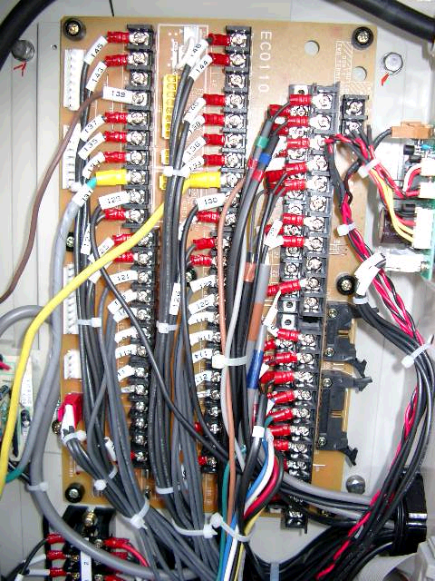
Replacement of controller (DECOSⅢc)
【Terminal board】
CN3
CN2
CN1
CN4
CN7
CN6

